Slide 1
Problem definition
Inputs
Outputs

Slide 2
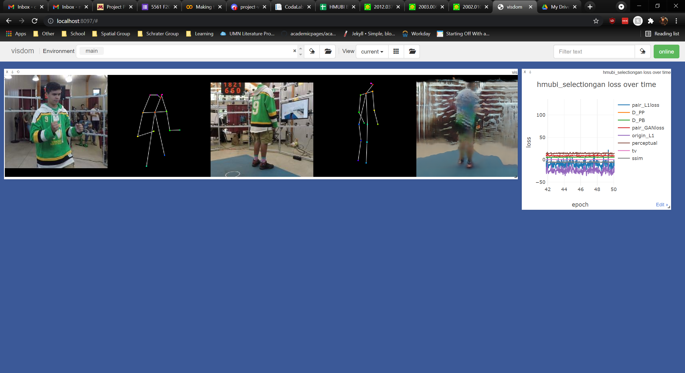
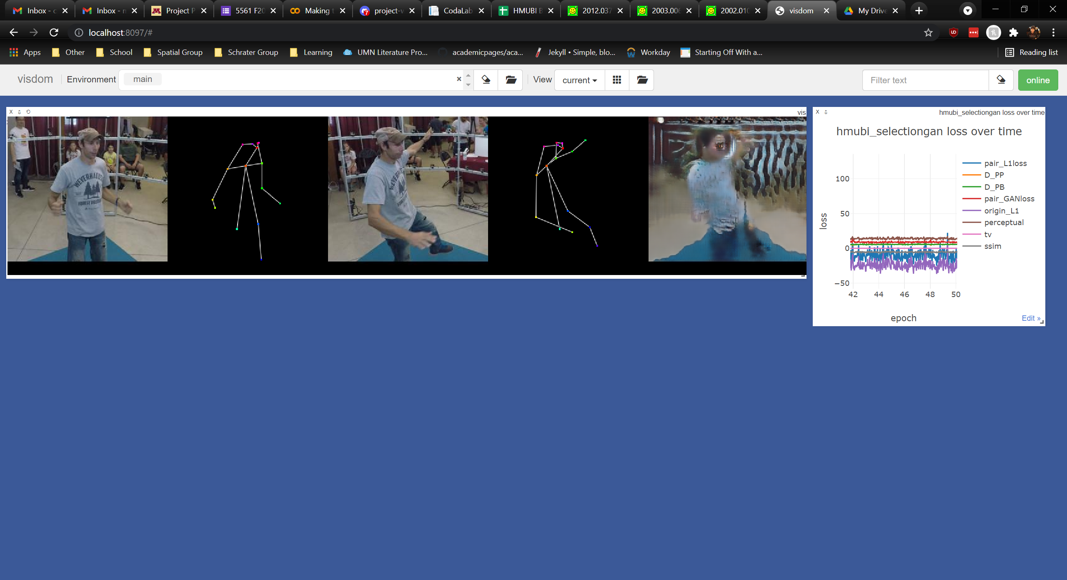
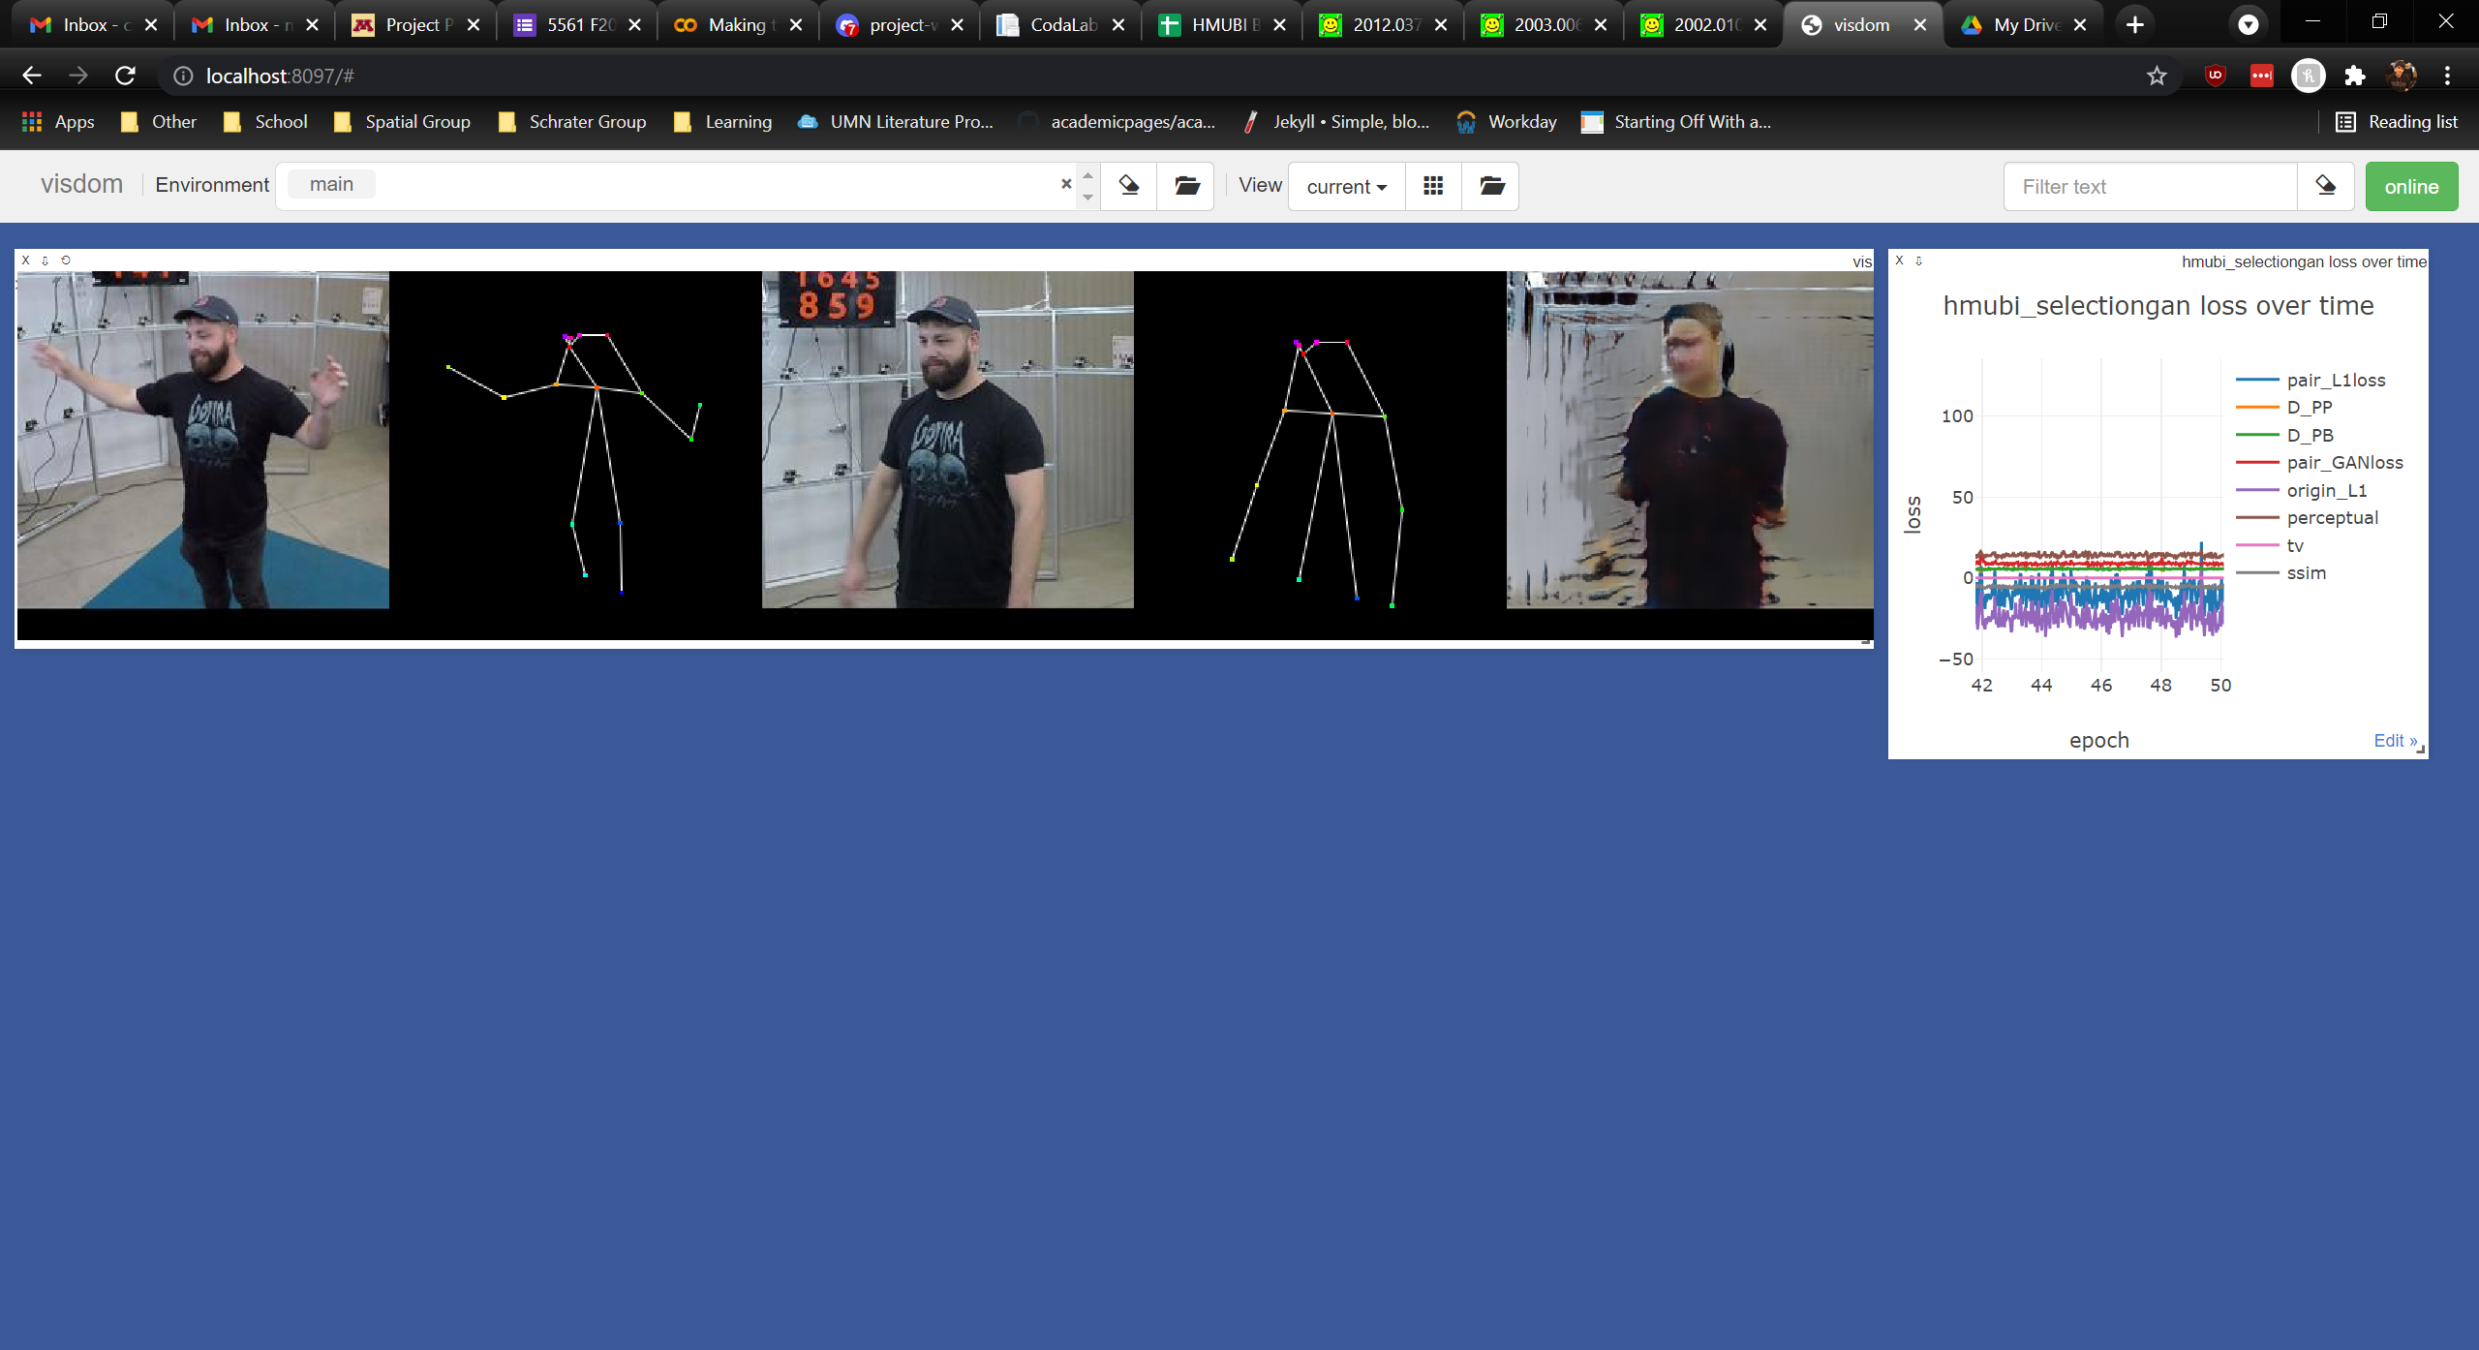
Baseline: SelectionGAN
Multi-Channel Attention Selection GANs for Guided Image-to-Image Translation https://arxiv.org/pdf/2002.01048.pdf

Slide 3
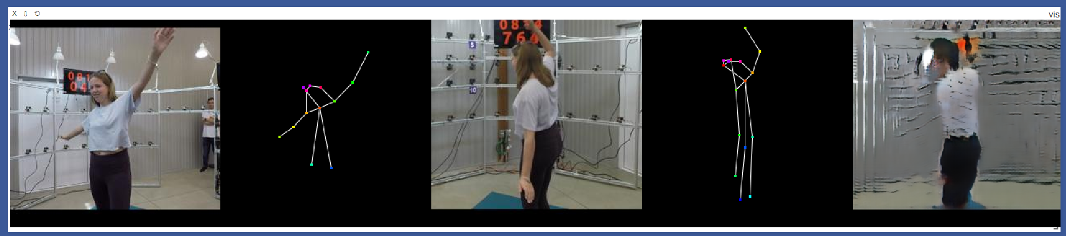
Baseline: SelectionGAN
Multi-Channel Attention Selection GANs for Guided Image-to-Image Translation https://arxiv.org/pdf/2002.01048.pdf
Limitations:
Blurry edges between clothes
Low detail on garments
Background is poorly rendered
Cannot distinguish between foreground and background

Slide 4
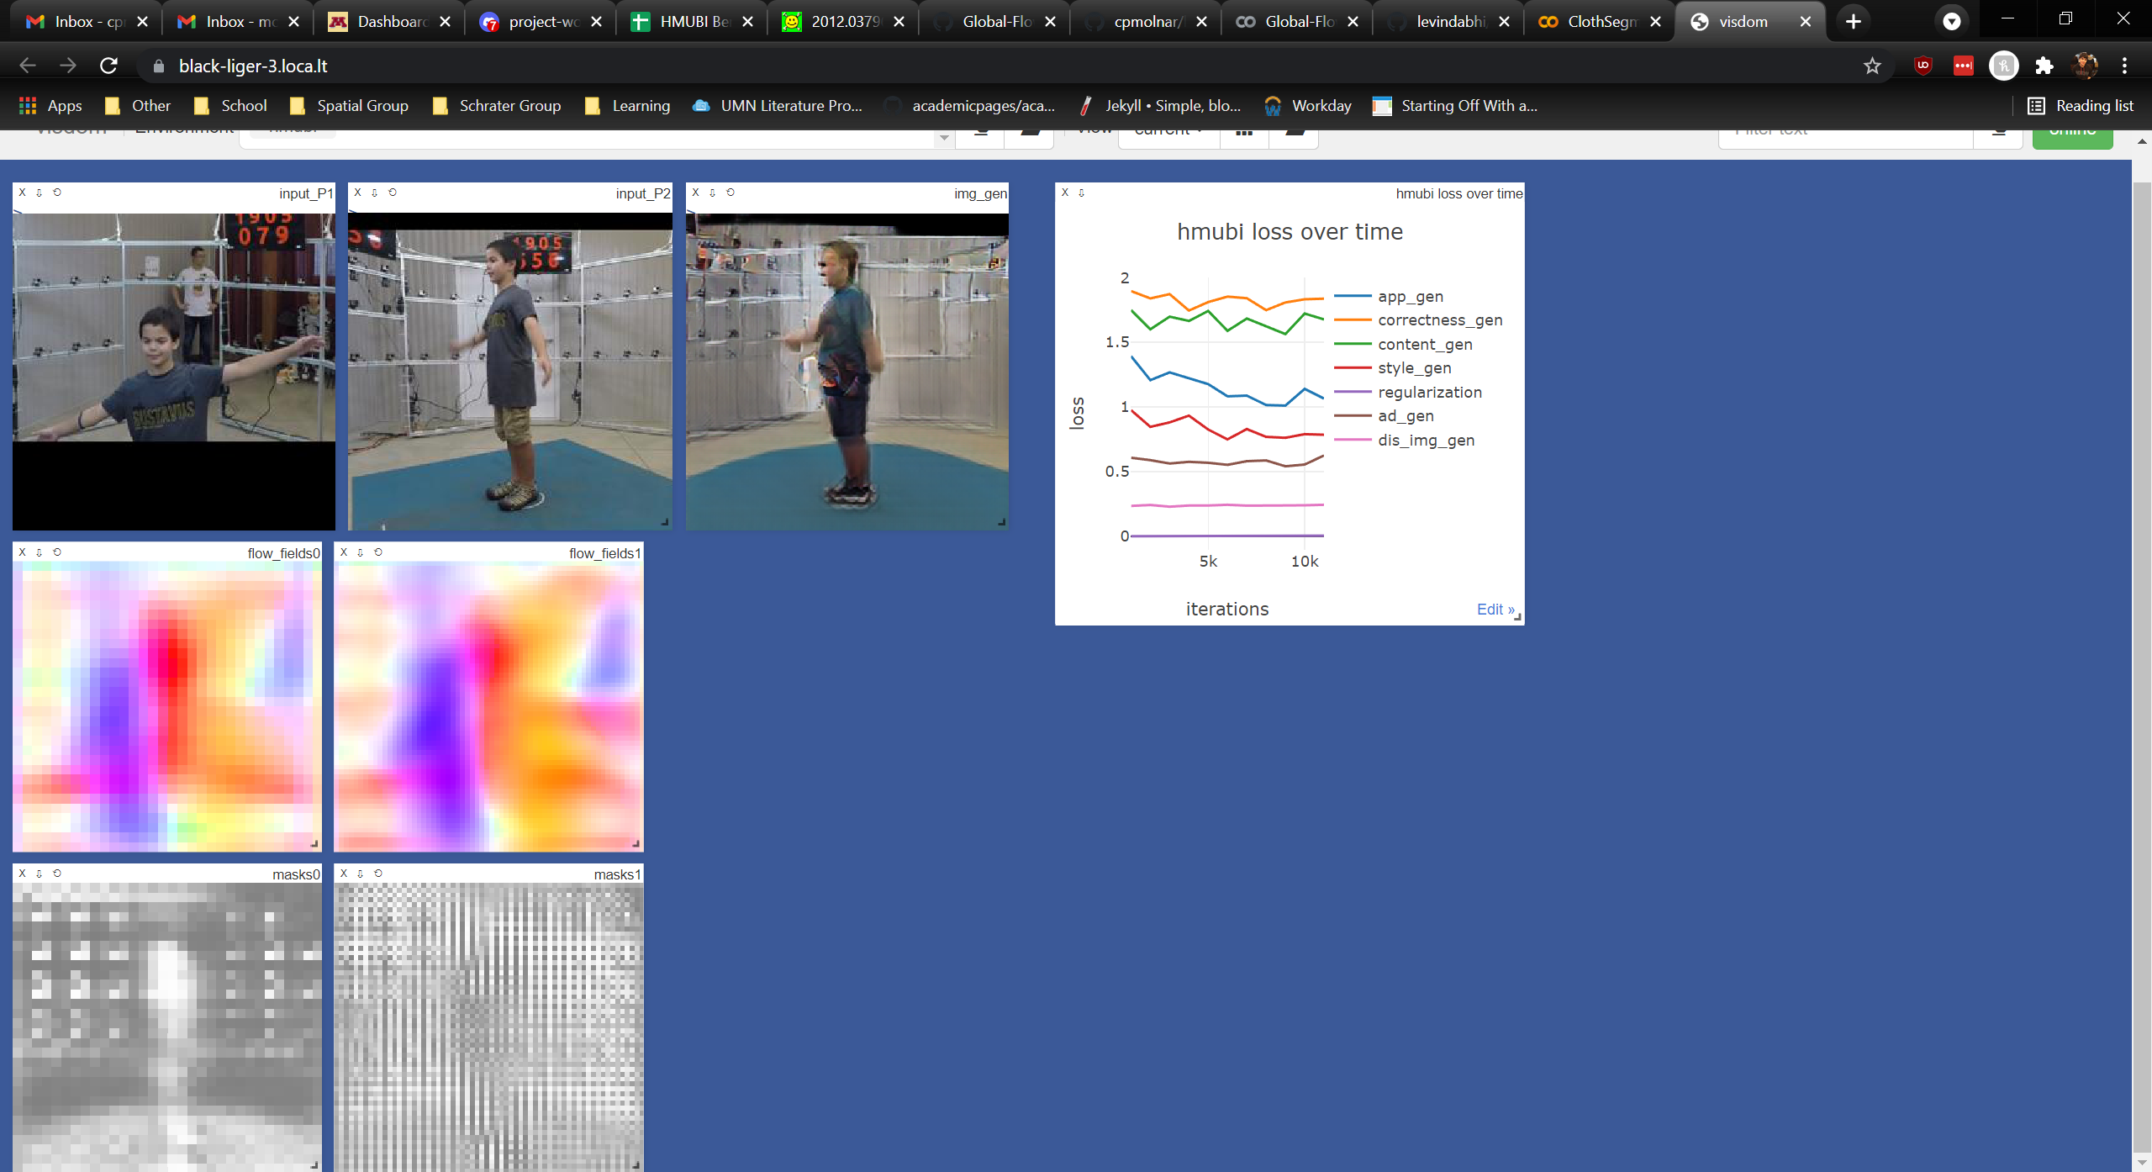
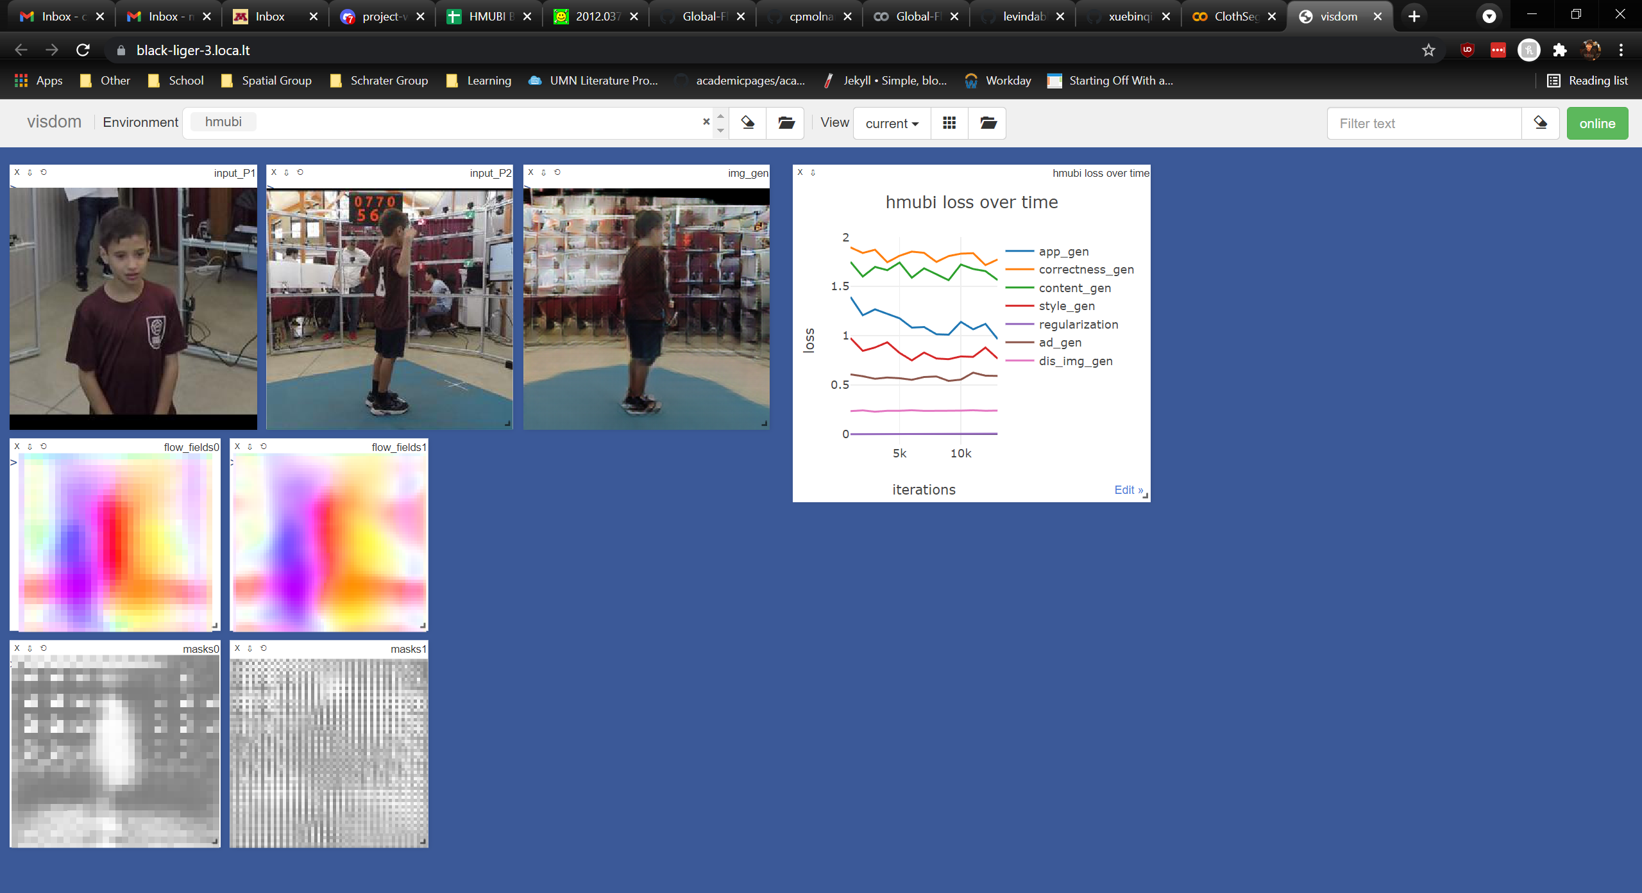
Baseline: Global-Flow-Local-Attention
Multi-Channel Attention Selection GANs for Guided Image-to-Image Translation https://arxiv.org/pdf/2002.01048.pdf

Slide 5
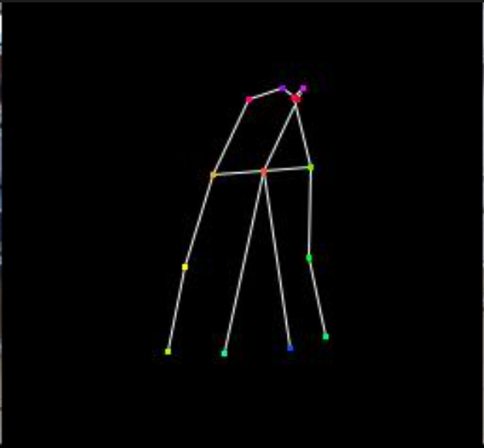
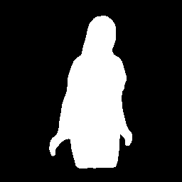
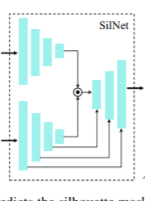
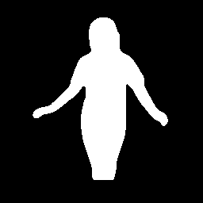
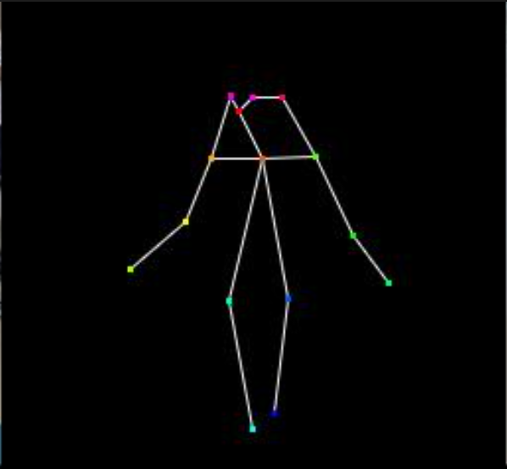
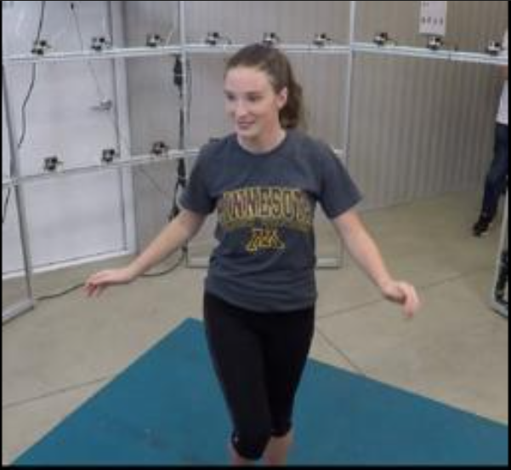
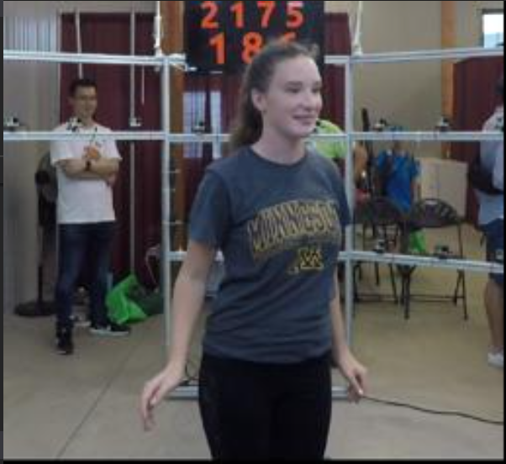
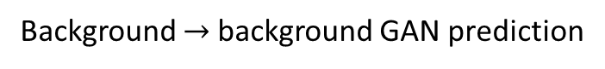
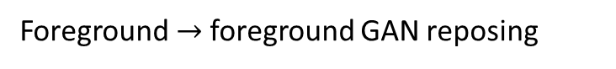
Approach: SilNet module from Pose-Guided Human Animation from a Single Image in the Wild
Idea: Separate the task of foreground and background prediction
Foreground $→$foreground GAN reposing
Background $→$background GAN prediction
Pose-Guided Human Animation from a Single Image in the Wild https://arxiv.org/pdf/2012.03796.pdf

Slide 6
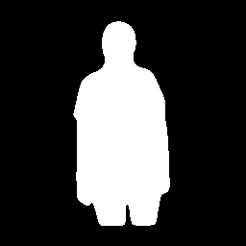
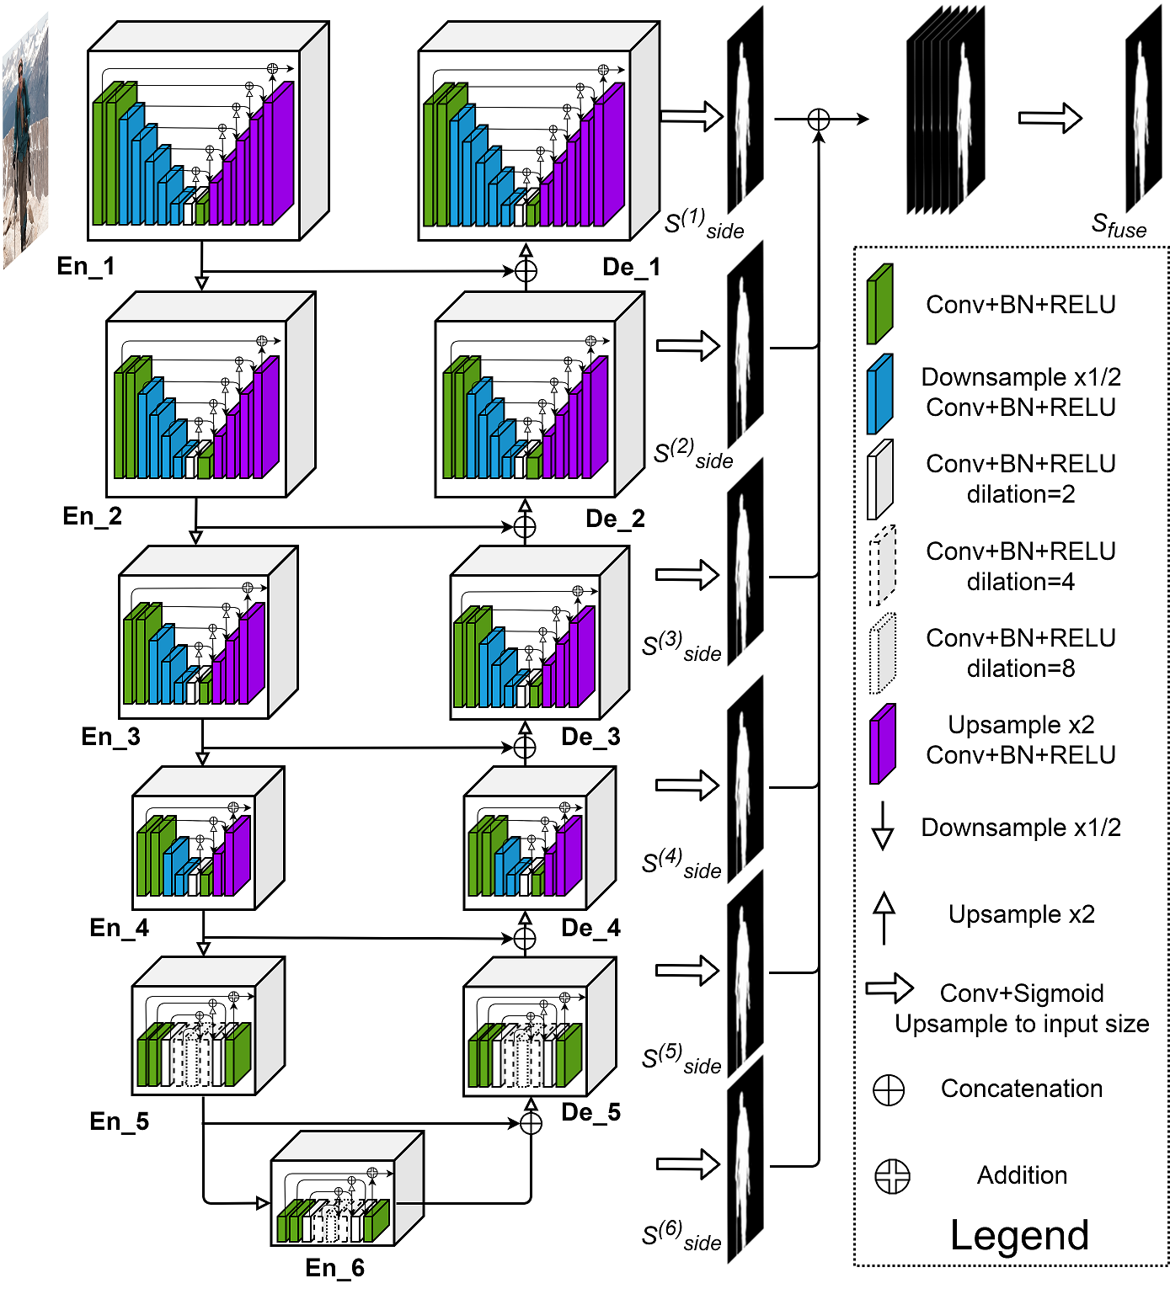
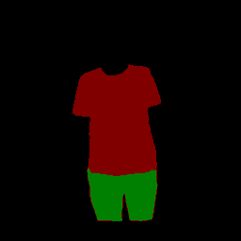
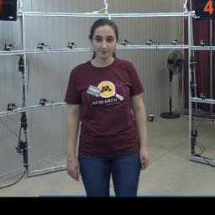
Approach: Foreground data augmentation with Garment Parsing or DensePose
https://github.com/levindabhi/cloth-segmentation
DensePose: Dense Human Pose Estimation In The Wild https://arxiv.org/pdf/1802.00434.pdf

Slide 7
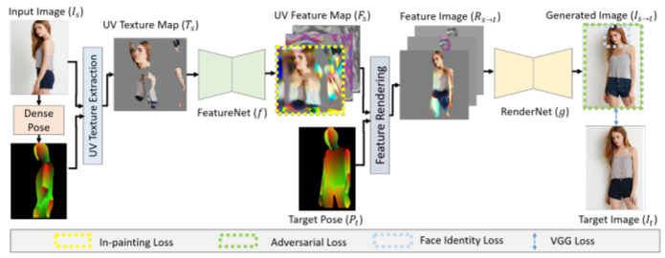
Approach: Solve texture and blur inconsistency with UV Map
Neural rerendering of humans from a single image https://arxiv.org/pdf/2101.04104.pdf

